Slide 1
SOCIAL VR
Heading towards the Metaverse

Slide 2
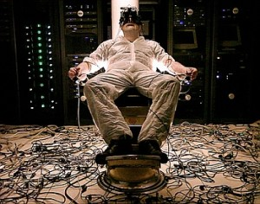
VR is inherently antisocial

Slide 3
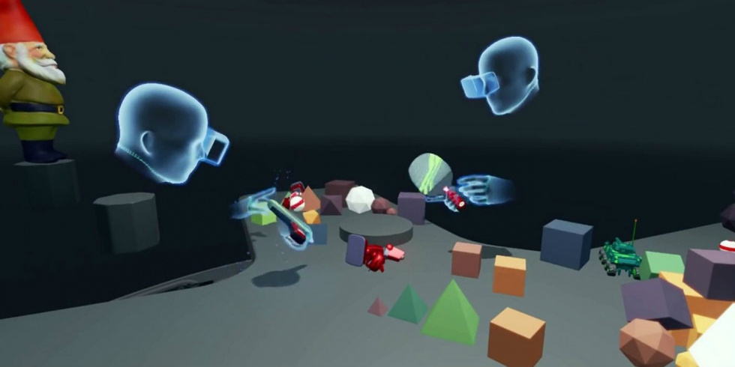
SOCIAL VR Enhances the EXPERIENCE

Slide 4
The early players
Facebook Rooms/Parties & AltspaceVR

Slide 5
The NEXT GENERATION – closer to the metaverse
Sansa & High Fidelity

Slide 6
THE DESTINATION
Ready Player One?

Slide 7
THE END

